Slide 1
Johnny Hooyberghs
Building an educational game with .NET Core and Unity

Slide 2

Johnny Hooyberghs
@djohnnieke
github.com/Djohnnie
www.involved-it.be

Slide 3
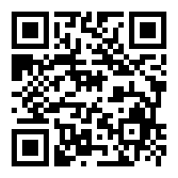
Download the following GIT-repository to start
https://github.com/Djohnnie/CSharpWars-NDCLondon-2020

Slide 4
What will you do after this talk?
☑ Have fun with .NET Core?
☑ Believe in .NET Core as a platform independent framework?
☑ Believe .NET is an easy tool to create a wide range of applications?
☒ Know all the details about .NET Core?
☒ Use Unity for your professional applications?
☒ Use Roslyn for your professional applications?
☒ Design AAA games using Unity?

Slide 5
Why?
Gamification to teach basic C# knowledge in school
Learn the Unity Game Engine
Play with the Microsoft Compiler Platform Roslyn
Play with .NET Core 3
Play with Azure DevOps Pipelines and Docker
Use Test Driven Development

Slide 6
Context
Robots on arena (15x15)
Robots take turns (every two seconds, simultaniously)
Robots can move around the grid
Robots can attack other robots
Robots can see part of the arena
A turn is scripted using C#
A robot runs a single script every two seconds
A robot has a limited amount of health and stamina

Slide 7


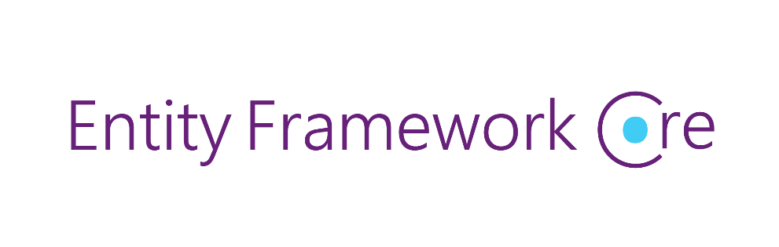




HTTP API
Robot Arena
SQL Database
Processing Middleware

Slide 8

Demo
Register as a player
Select a pre-defined script
Create your robot
Watch your robot struggle
http://csharpwars.azurefd.net/

Slide 9
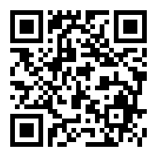
johnny.hooyberghs@involved-it.be
@djohnnieke
https://github.com/Djohnnie/CSharpWars

